Slide 1
Data Scraping Tool
Fall 2022

Slide 2

Introduction
Data Scraping Tool
Maya Cooper, Noah Garman, Michael McBratney, Tian Zhao
Our Client
Dr. Adam Du Pon, a professor from the Parker College of Business
What problem is being solved?
Our client needs an automated way to extract term frequency data from 10-K filings in order to research the associations between the various facets of a company, such as its operational strategy or workplace culture, and how said company performs in the real world
Such research can help investors make better informed decisions when choosing where to keep their money, in addition to providing valuable insights to companies themselves about what may or may not work with their business model

Slide 3

Background Information
The United States Securities and Exchange Commission (SEC) is an oversight agency responsible for regulating the securities market and protecting investors. Most publicly traded companies are required to file annual reports, known as Form 10-K’s. These reports give significant insight into the business environment, operational model, and financial status of a company. Of interest to this project is a section labeled “Item 1,” which discusses the scope and mechanisms of a company’s operation
These forms are contained in the SEC’s EDGAR (Electronic Data Gathering, Analysis, and Retrieval system) database, which is a system that is provided by the SEC, for querying financial documents. There are existing API’s for EDGAR, however they are all locked behind a paywall, meaning that a custom scraper needed to be developed
Notes:
1:30

Slide 4
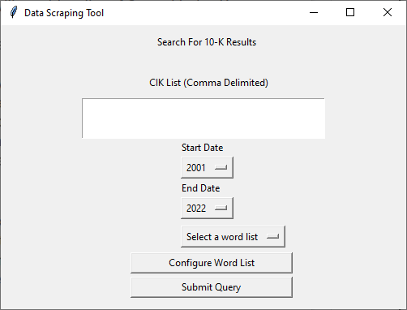
Program Design
Overall Design
GUI-Based
The user will provide a list of Central Index Keys (CIK’s), which are the unique identifiers of companies in EDGAR, in addition to custom key term lists. They can also specify the range of years for which to retrieve the filings
The program will retrieve the Form 10-K’s as specified by the user, extract Item 1 where possible, and compute term frequency data, after which data is written to a file of the user’s choice
Challenges
Retrieving Form 10-K’s from EDGAR
Properly extracting Item 1
Not all filings are formatted correctly
Certain filings combine Item 1 and 2, meaning they should be excluded
Creating a responsive/reliable progress indicator
Building

Slide 5
Coding Implementations
All GUI windows for this application were made using the Python Tkinter library
CIK numbers were checked against the SEC’s list of all companies before being querying. This list updates each time the program is opened.
10-K filings are scraped from the EDGAR database hosted on by SEC
Content of 10-K forms was retrieved using beautifulsoup, an HTML parser, and Item 1 was isolated using regular expressions
Output data was exported and saved in a comma delimited format

Slide 6

Demo
Backup Video

Slide 7
Conclusion
Application
This program can easily be adapted to tackle many different use cases in the financial field
Possible future applications:
Statistical analysis of the relationship between word usage in a 10-K filing, and financial performance
Analysis of the relationship between word usage in a 10-K filing and employment/layoff rates
This program could be adapted to look at additional documents or transcripts of company meetings, and scrape word frequency data from those
Final Thoughts
We created a product that successfully satisfied our client’s requirements and provided our teammates with a valuable programming experience. We are excited to see how this type of application might be adapted to tackle additional problems in the financial industry in the future

